Slide 1
FAKE NEWS DETECTION USING AUTOENCODERS
PRAVEENA R
au21AIB66
KGiSL INSTITUTE OF TECHNOLOGY
3/21/2024 Annual Review

Slide 2
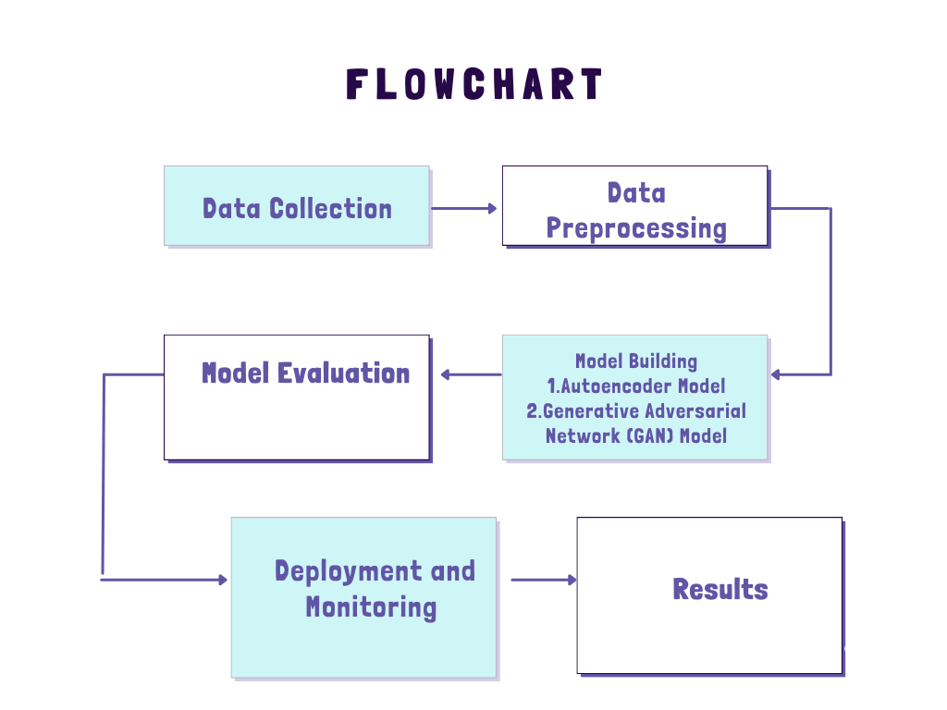
FAKE NEWS DETECTION USING AUTOENCODERS
3/21/2024 Annual Review

Slide 3


AGENDA
PROBLEM STATEMENT
PROJECT OVERVIEW
WHO ARE THE END USERS?
SOLUTION
WOW IN THE SOLUTION
MODEL
RESULT
3/21/2024 Annual Review

Slide 4

PROBLEM STATEMENT
The task involves developing a robust fake news detection system capable of accurately distinguishing between real and fake news articles. Given the proliferation of misinformation on social media and other online platforms, the goal is to create a solution that can automatically identify deceptive or misleading content, thereby helping to mitigate the spread of false information and preserve the integrity of online discourse.
3/21/2024 Annual Review

Slide 5

PROJECT OVERVIEW
Generative Adversarial Networks (GANs) and autoencoders have distinct roles in machine learning. GANs generate new data resembling a given dataset by training a generator and discriminator simultaneously.
Autoencoders compress input data into a lower-dimensional representation and reconstruct it. While GANs and autoencoders have applications in data generation and dimensionality reduction, they aren't commonly used directly for fake news detection. Fake news detection systems primarily employ NLP techniques like text classification and sentiment analysis, often using supervised learning with algorithms like SVMs, random forests, or deep learning models like RNNs and CNNs.
Thus, while GANs and autoencoders play roles in data processing, they aren't the primary methods for fake news detection.
3/21/2024 Annual Review

Slide 6

WHO ARE THE END USERS?
1. Social Media Platforms
2. News Organizations
3. Government Agencies
4. Educational Institutions
5. Fact-Checking Organizations
6. General Public
3/21/2024 Annual Review

Slide 7

SOLUTION AND PROPOSITION
Autoencoders for Feature Extraction: Autoencoders are utilized to extract meaningful features from the textual content of news articles. By encoding the input data into a lower-dimensional representation, autoencoders capture the underlying patterns and semantics that distinguish between genuine and fake news.
Generative Adversarial Networks for Data Augmentation: GANs are employed to generate synthetic examples of both real and fake news articles. This process helps in augmenting the dataset, enabling the model to learn a more comprehensive set of features and improve its robustness to different types of fake news.
Model Integration and Training: The extracted features from autoencoders and synthetic data from GANs are combined to train a classification model. This model learns to distinguish between real and fake news articles based on the learned representations. The training process involves optimizing the model parameters to minimize classification errors and improve overall accuracy.
Evaluation and Validation: The performance of the fake news detection system is evaluated using standard metrics such as accuracy, precision, recall, and F1-score. The system is validated using a separate test dataset to assess its generalization ability and effectiveness in real-world scenarios.
Deployment and Application: Once trained and validated, the fake news detection system can be deployed in various contexts such as social media platforms, news websites, and online forums. It serves as a valuable tool for identifying and combating misinformation, thereby promoting informed decision-making and safeguarding the integrity of information dissemination channels.
3/21/2024 Annual Review

Slide 8

THE WOW IN YOUR SOLUTION
1. Feature Extraction
2. Data Augmentation
3. Improved Performance
4. Enhanced Generalization
5. Reduced Overfitting
6. Adaptability
3/21/2024 Annual Review

Slide 9
MODELLING
In fake news detection, various models and techniques can be employed depending on the nature of the data and the specific requirements of the task. Here are some common models used in fake news detection:
1. Traditional Machine Learning Models:
- Logistic Regression
- Support Vector Machines (SVM)
- Random Forest
- Naive Bayes
2. Deep Learning Models:
- Recurrent Neural Networks (RNNs)
- Convolutional Neural Networks (CNNs)
- Long Short-Term Memory (LSTM) Networks
- Gated Recurrent Units (GRUs)
3. Ensemble Models:
- Voting Classifier
- Bagging and Boosting Techniques (e.g., AdaBoost, XGBoost)

Slide 10
MODELLING
4. Transformer-Based Models:
- BERT (Bidirectional Encoder Representations from Transformers)
- GPT (Generative Pre-trained Transformer)
6. Generative Adversarial Networks (GANs):
- GANs can be used to generate fake news articles for data augmentation or to detect patterns in fake news content.
7. Hybrid Models:
- Combining multiple models and techniques to improve overall performance and robustness.
3/21/2024 Annual Review

Slide 11
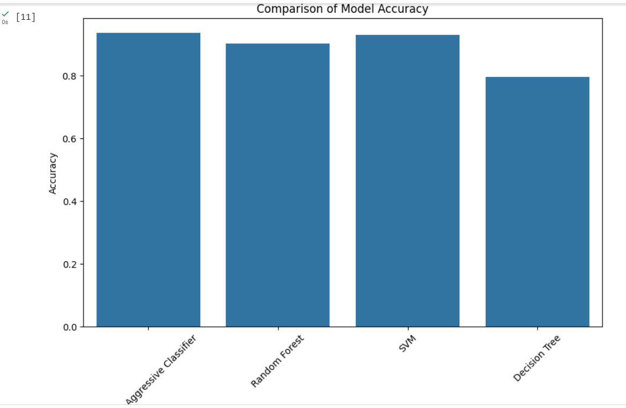
RESULTS
3/21/2024 Annual Review

